Slide 1
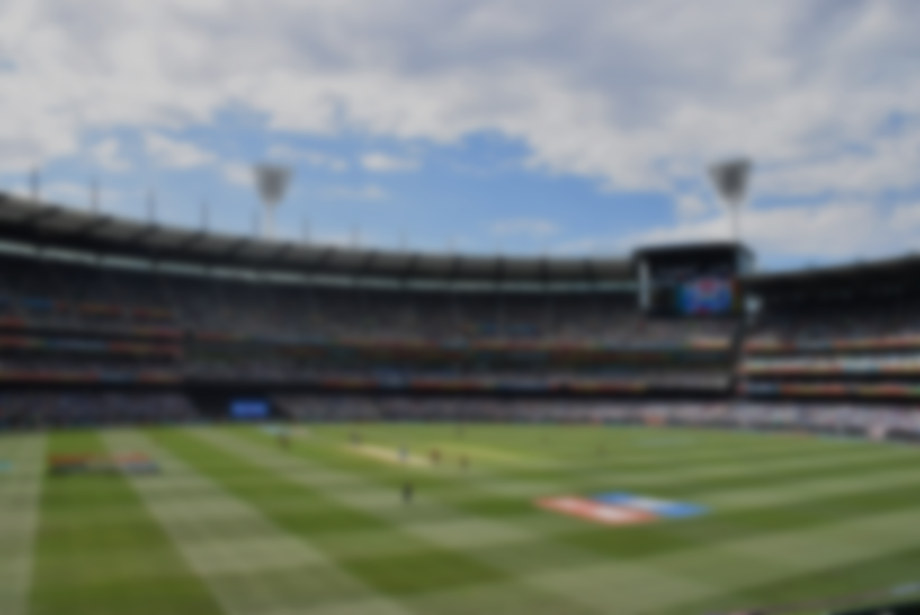



ThE cricat win predictor
presents
FOR INTERNATIONAL CRICKET MATCHES

Slide 2

TimeLine
Introduction​
Our Objective
​Industrial Relevance
How do we get there?
How does it work?
​Summary​ and plans

Slide 3

Introduction
Whenever we talk about data and statistics in real life, we see their practical use very occasionally. It is not that if they are used less by us, means they are used less by others too. Probability and Statistics play a very heavy role in the sectors of science, technology, and also many other things. Using Data Analysis we are creating a cricket match win predictor, which would use tons of data, major statistical tools, and concepts to predict which team would have the highest probability of winning the game. Herein, the application would take data like team name, player 11, captain’s name, toss result, place of the match, weather, etc. to predict the most probable result. Finally, our goal would be achieved that is to use statistical analysis and probability tools in real life for solving some practical purpose. Now all these mentioned factors don’t have the same values in everybody’s opinion, some people believe the records to be the most important criterion for a team to win, whereas some believe it’s their playing 11. So our goal is to focus on this factor and make it user based.

Slide 4
The sciences do not try to explain, they hardly even try to interpret, they mainly make models. A model is meant a mathematical construct that, with the addition of certain verbal interpretations, describes observed phenomena. The justification of such a mathematical construct is solely and precisely that it is expected to work.
“
”

Slide 5
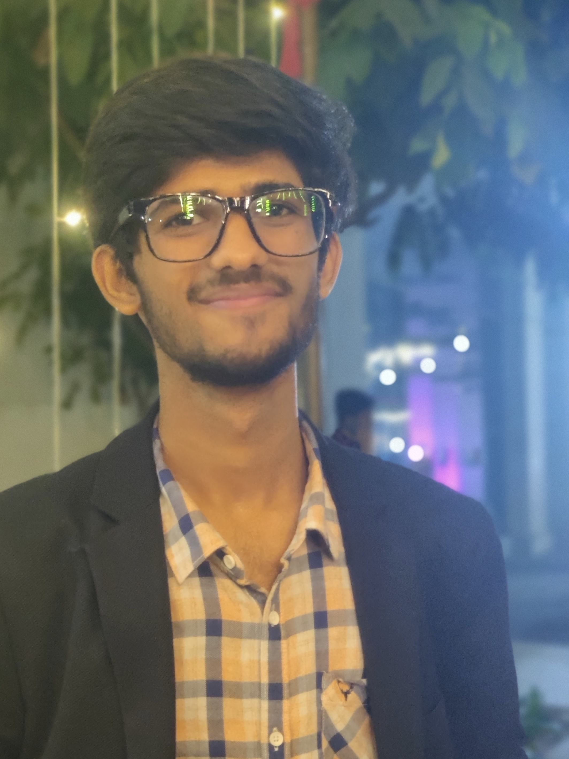
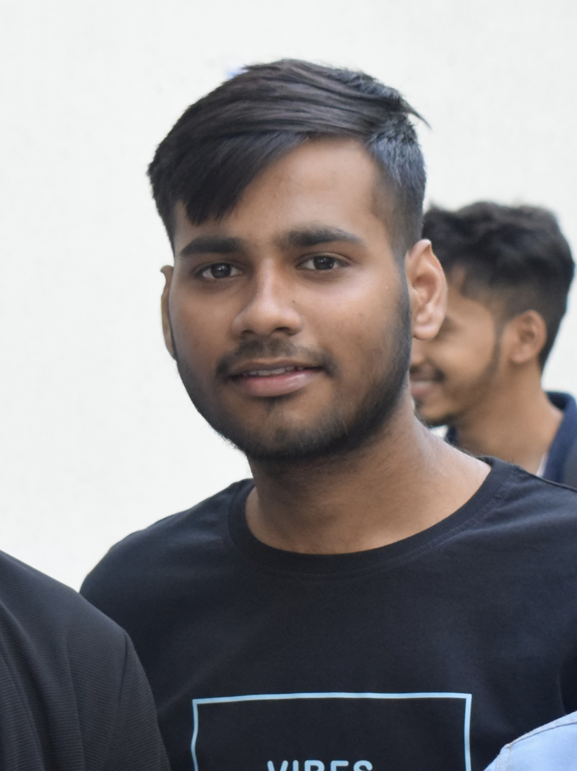

MEET OUR TEAM!
Abhyuday rai
e21cseu0130
Aditya singh ghuraiya
e21cseu0152
Aditya raj
e21cseu0143

Slide 6


PRIMARY GOAL
Using Data Analysis And Statistical Tools To Predict Cricket Match Outcome

Slide 7
Industrial relevance
Gambling? betting? Or something better?
Why ours is useful?
Nowadays this thing is booming in our country, with applications like betway, parimatch, dream11, and whatnot.
This is a huge market in the future, estimated to be around some 100 billion dollars to even a trillion dollars of capital.
This app of ours would not only help in betting for the team to win but in the future will also be developed in such a way that we would be able to choose players according to their stats and create a better team for specific tournaments.
This app is also created keeping in mind things like illegal betting, so this is a safe option for kids as well for them to get aware of how powerful of a tool statistics could be.
Entertainment value
A Chance to make money
Convenient
Easy to get started

Slide 8




HOW WE GET THERE
Collection of data
(Lots of data!)
Applying statistical operations
Gui to make it better
to visualize
Collecting players’ stats of each major team playing international matches
Stats would be collected separately for diff formats
Player vs Player data would be collected, toss to match history, stadium, and country analysis to be done.
Filtering out relevant data and creating useful datasets to be able to perform functions efficiently.
Apply required statistics on clean data to get the required results.
Would be applied only on playing 2 teams.
Once the things at the back are running fine, would focus on GUI creation for a better showcase of results.
GUI will interact with the user to take relevant inputs and provide the output.

Slide 9
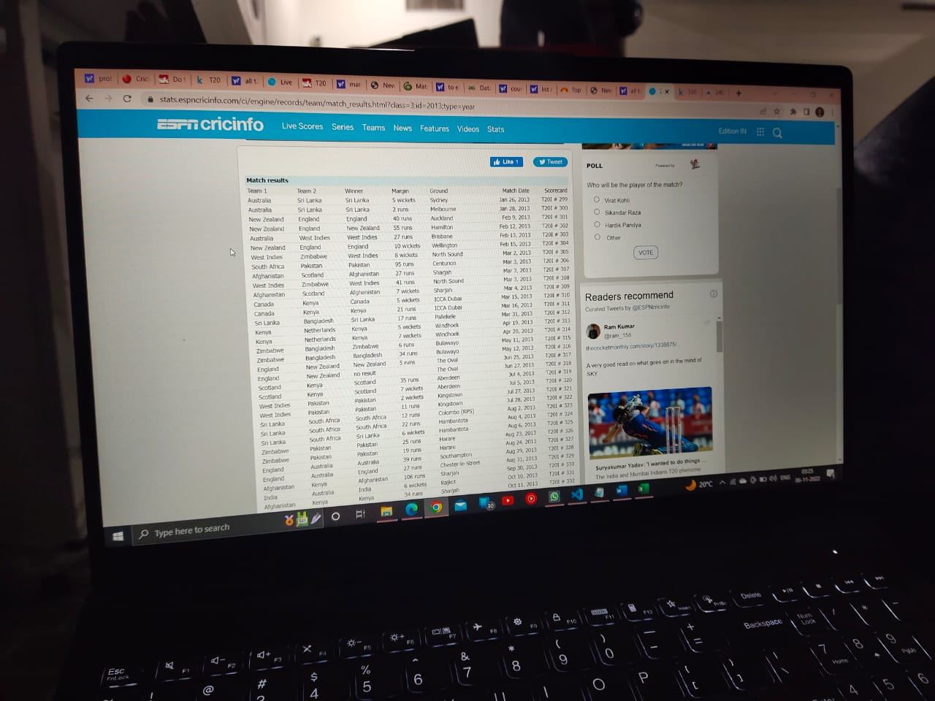
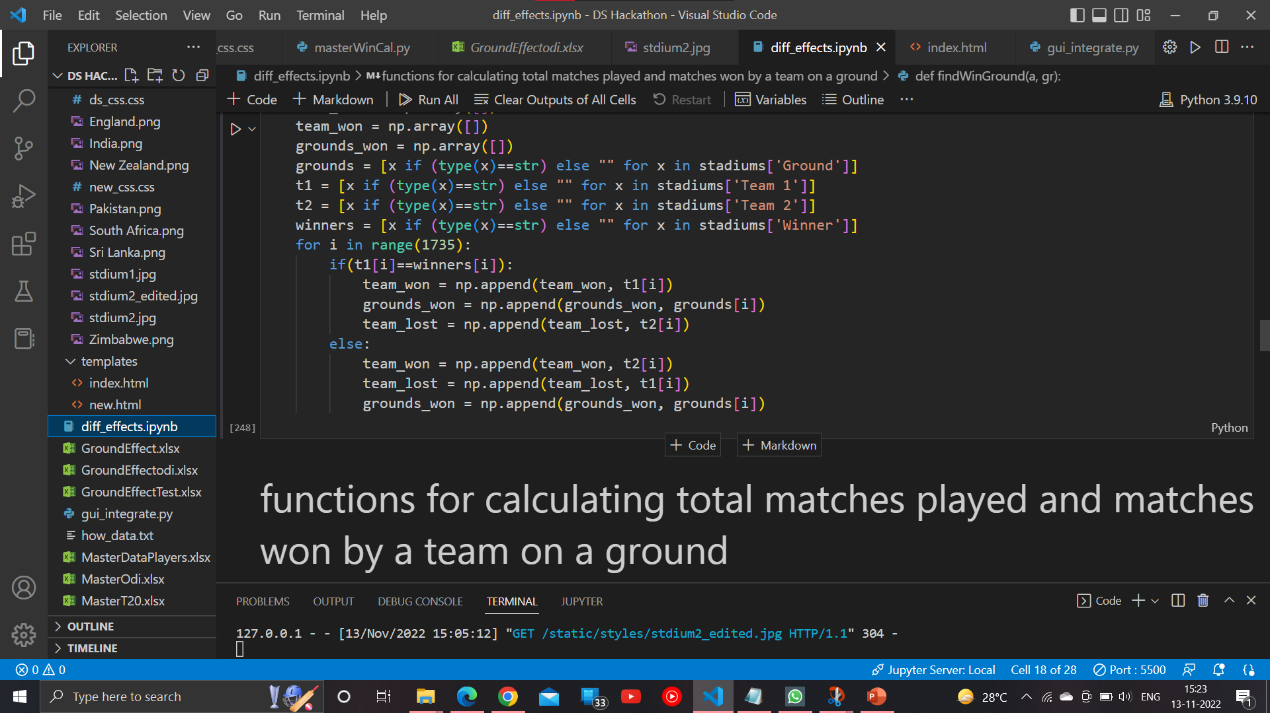
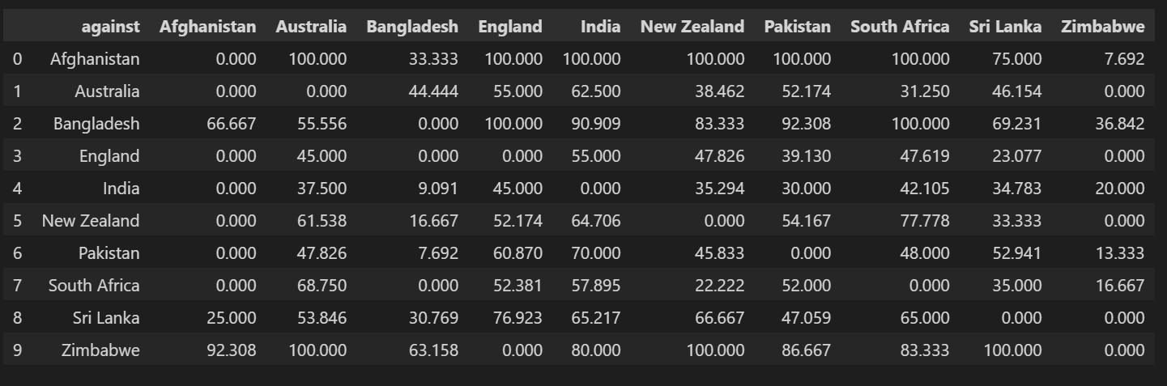
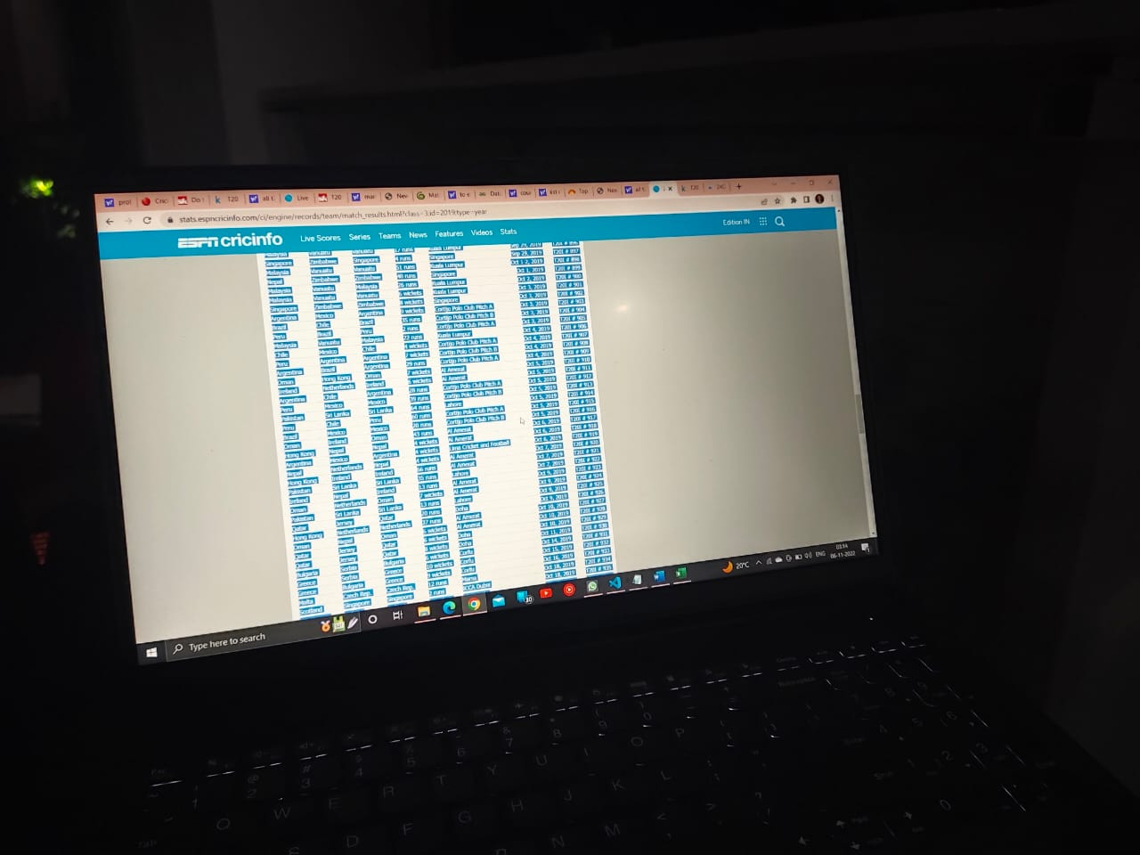
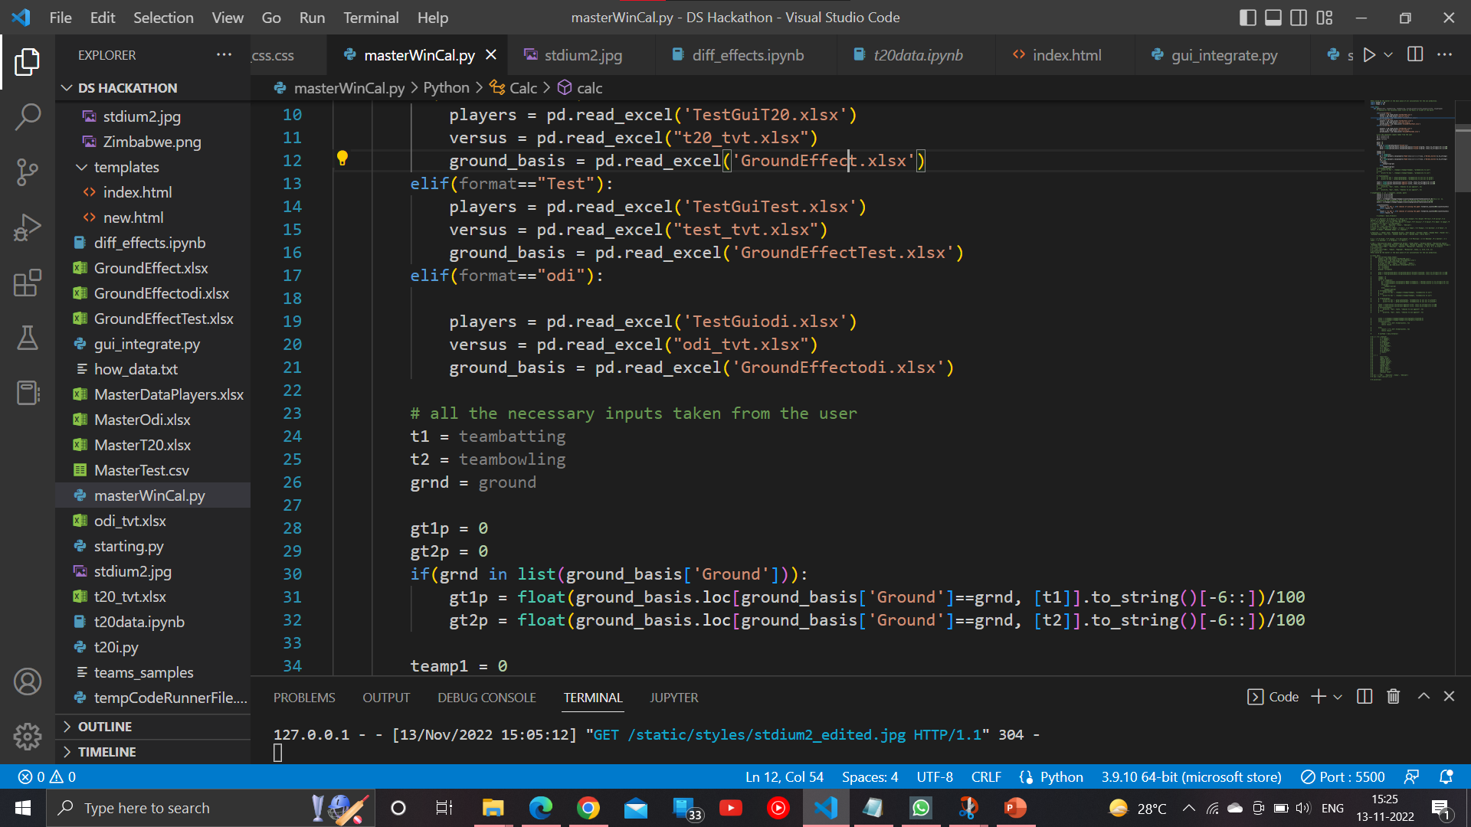
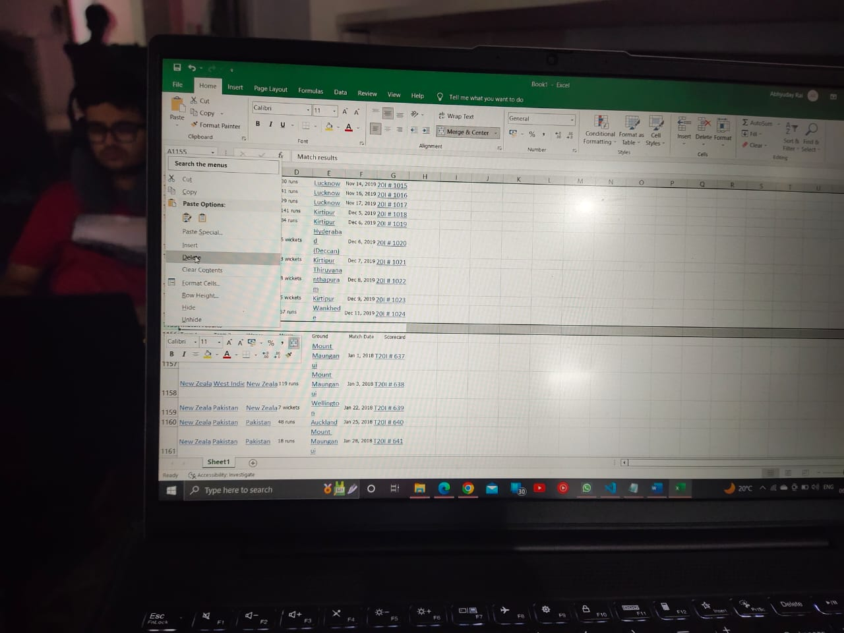
How was the Process?
Searching Data
Cleaning DataSets
Creating MasterDataSets
Collecting Data
Creating DataSets
Making the programs

Slide 10


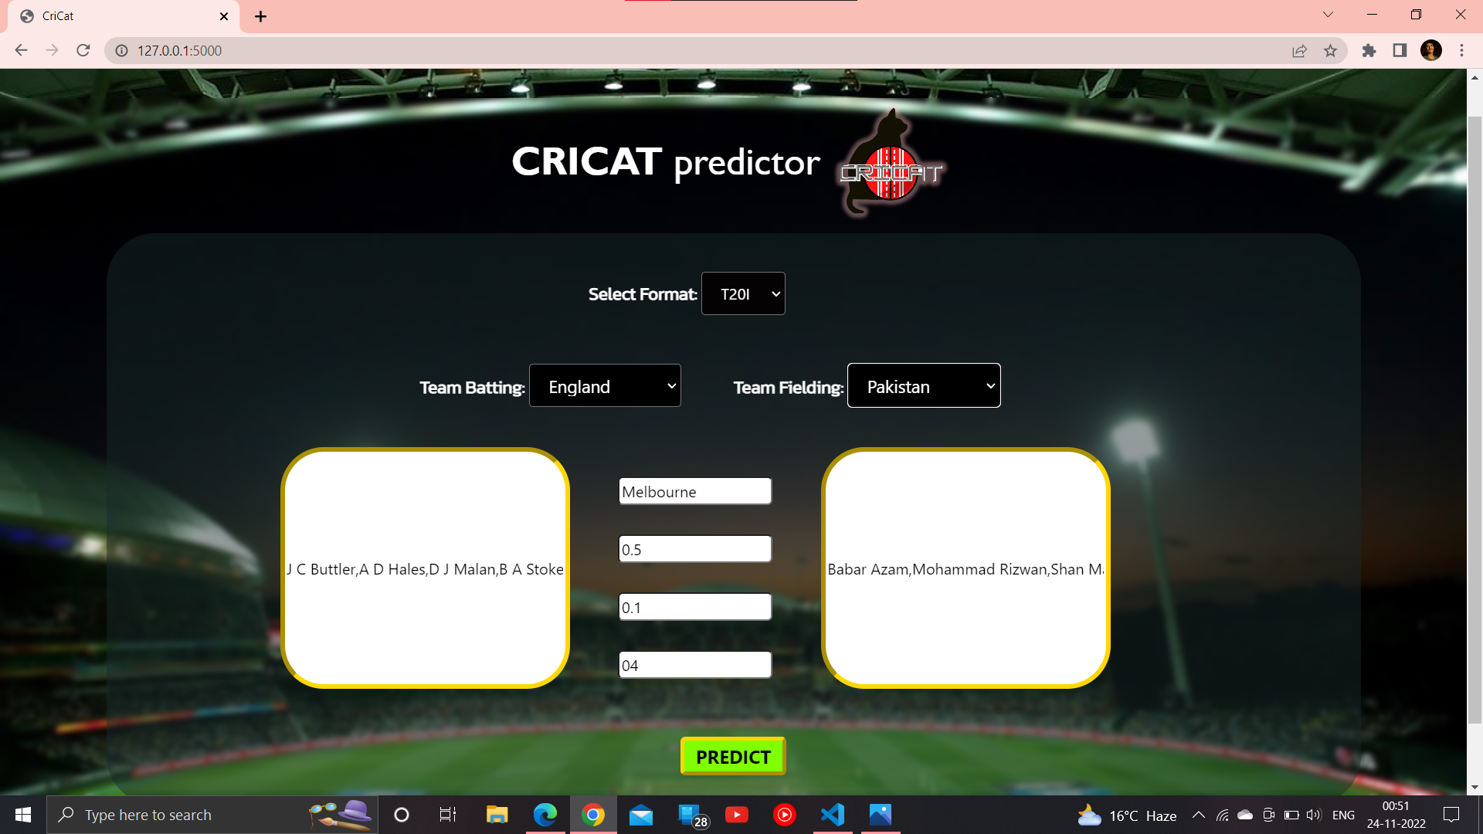
How does it work?
Tools used:
Python
HTML
CSS
Flask lib.
Pandas lib.
SciPy lib.
NumPy lib.
MS Excel

Slide 11
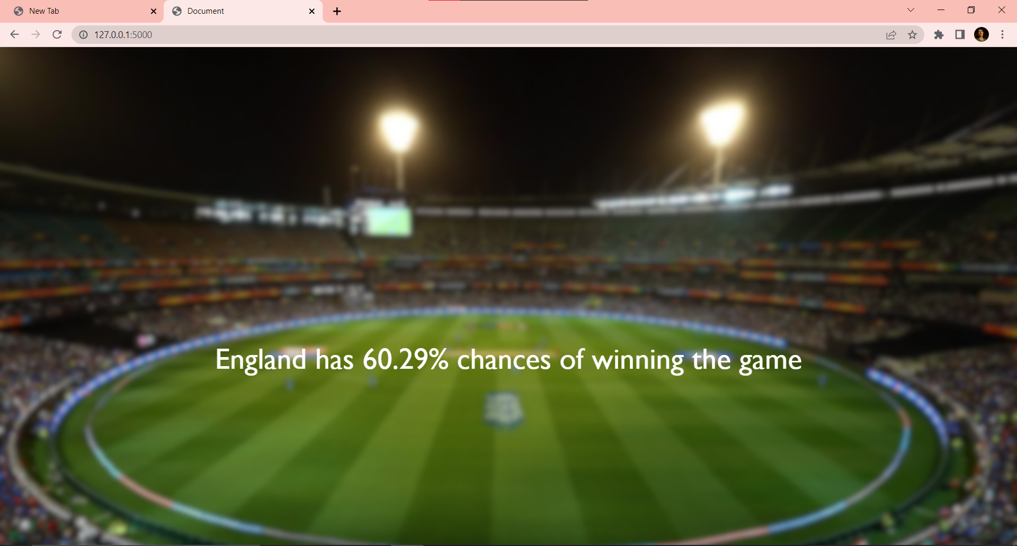
How does it work?
This is how the output looks like

Slide 12
Conclusion and Future plan
As mentioned in the abstract and the introduction, the application works perfectly fine and give precise results if the factors are given proper weightage. Tough there are many flaws too, on which we would have to work and those are mainly related to frontend and backend integration. Also, for the future plans, we plan the following add-ons in the application:
• Adding more dependencies like Weather factors, captaincy Records etc.
• Making it more user friendly, efficient and easy to use.
• Making it available for diff cricket leagues like IPL.

Slide 13
THANK YOU
Team BLACKBOX
Team Number: 41
Project- CRICAT WIN PREDICTOR

